Slide 1
IBM Cloud - Cloud Object Storage

Slide 2
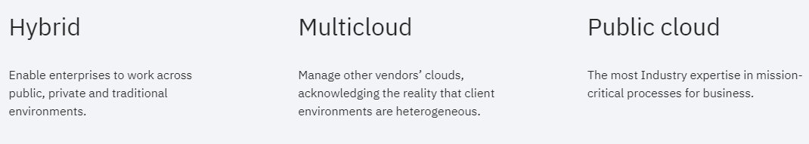
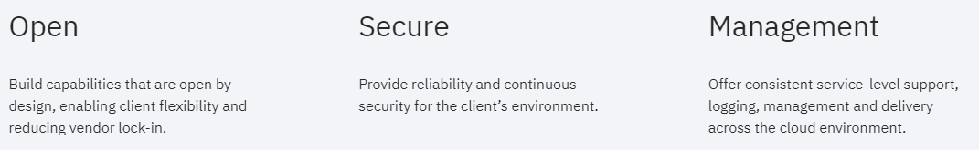
What is the IBM Cloud platform?
Platform as a service (PaaS) with infrastructure as a service (IaaS) to provide an integrated experience
Hybrid cloud combines and unifies public cloud and private cloud services from multiple cloud vendors to create a single, flexible, cost-optimal IT infrastructure

Slide 3
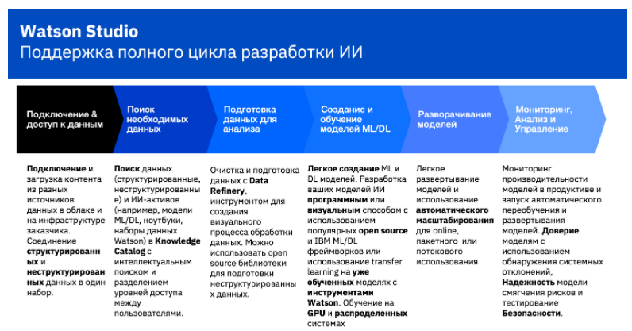
The US Open with Watson
https://www.ibm.com/sports/usopen/
https://habr.com/ru/company/ibm/blog/440182/

Slide 4
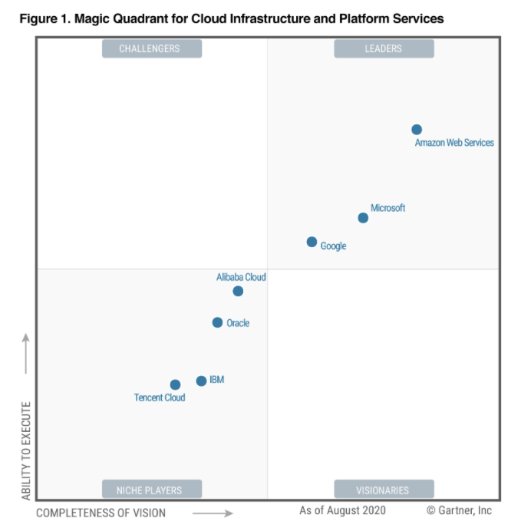
https://www.gartner.com/doc/reprints?id=1-1ZDZDMTF&ct=200703&st=sb

Slide 5
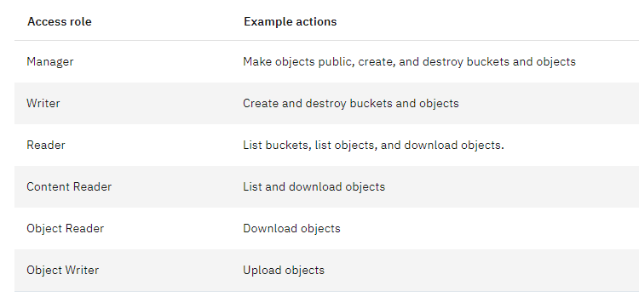
Getting started with IBM COS
1) Create a service instance of IBM COS;
2) Create a bucket: start by choosing a unique name,
you should have correct permissions to create a bucket,
choose the level of resiliency (cross region, regional, single data center),
choose a location,
choose the bucket's storage class (smart tier, standard, vault, cold vault),
if it’s needed, determine the advanced configurations (Rules and policies: archive rule, expiration, retention policy, static website hosting; key management services);
3) add some objects to the bucket

Slide 6
Using Cyberduck
https://cyberduck.io/
Select “Amazon S3”
Server: The Cloud Object Storage service endpoint URL (public only) for your location or region (s3.eu-de.cloud-object-storage.appdomain.cloud for example)
Secret access key: The secret access key of the instance from created HMAC creds
Access key ID: The access key ID of the instance from created HMAC service credentials.
After connection you can create pre-signed urls, sync data, delete folders, see all data

Slide 7
Using SQL Query
IBM Cloud SQL Query is a fully-managed service to run SQL queries (only SELECT statements) to analyze, transform, or clean up rectangular data.
CREATE, DELETE, INSERT, and UPDATE are not possible.
Input data is read from ORC, CSV, JSON, or Parquet files located in one or more IBM Cloud Object Storage instances
Valid query result object types are: AVRO, CSV, JSON, ORC, or PARQUET. Note that object type names are not case sensitive.
SQL Query accepts wildcards, so, for example, if you have lots of files in a bucket with the same name and distinguished by a month and year (e.g., example-032018), you could combine them all into a single table by selecting cos://us-geo/example-bucket/example-* or cos://us-geo/example-bucket/example-.

Slide 8
Using cURL
https://cloud.ibm.com/docs/cloud-object-storage?topic=cloud-object-storage-curl
See the file “Curl with IBM Cloud Object Storage (COS).docx“

